Slide 1
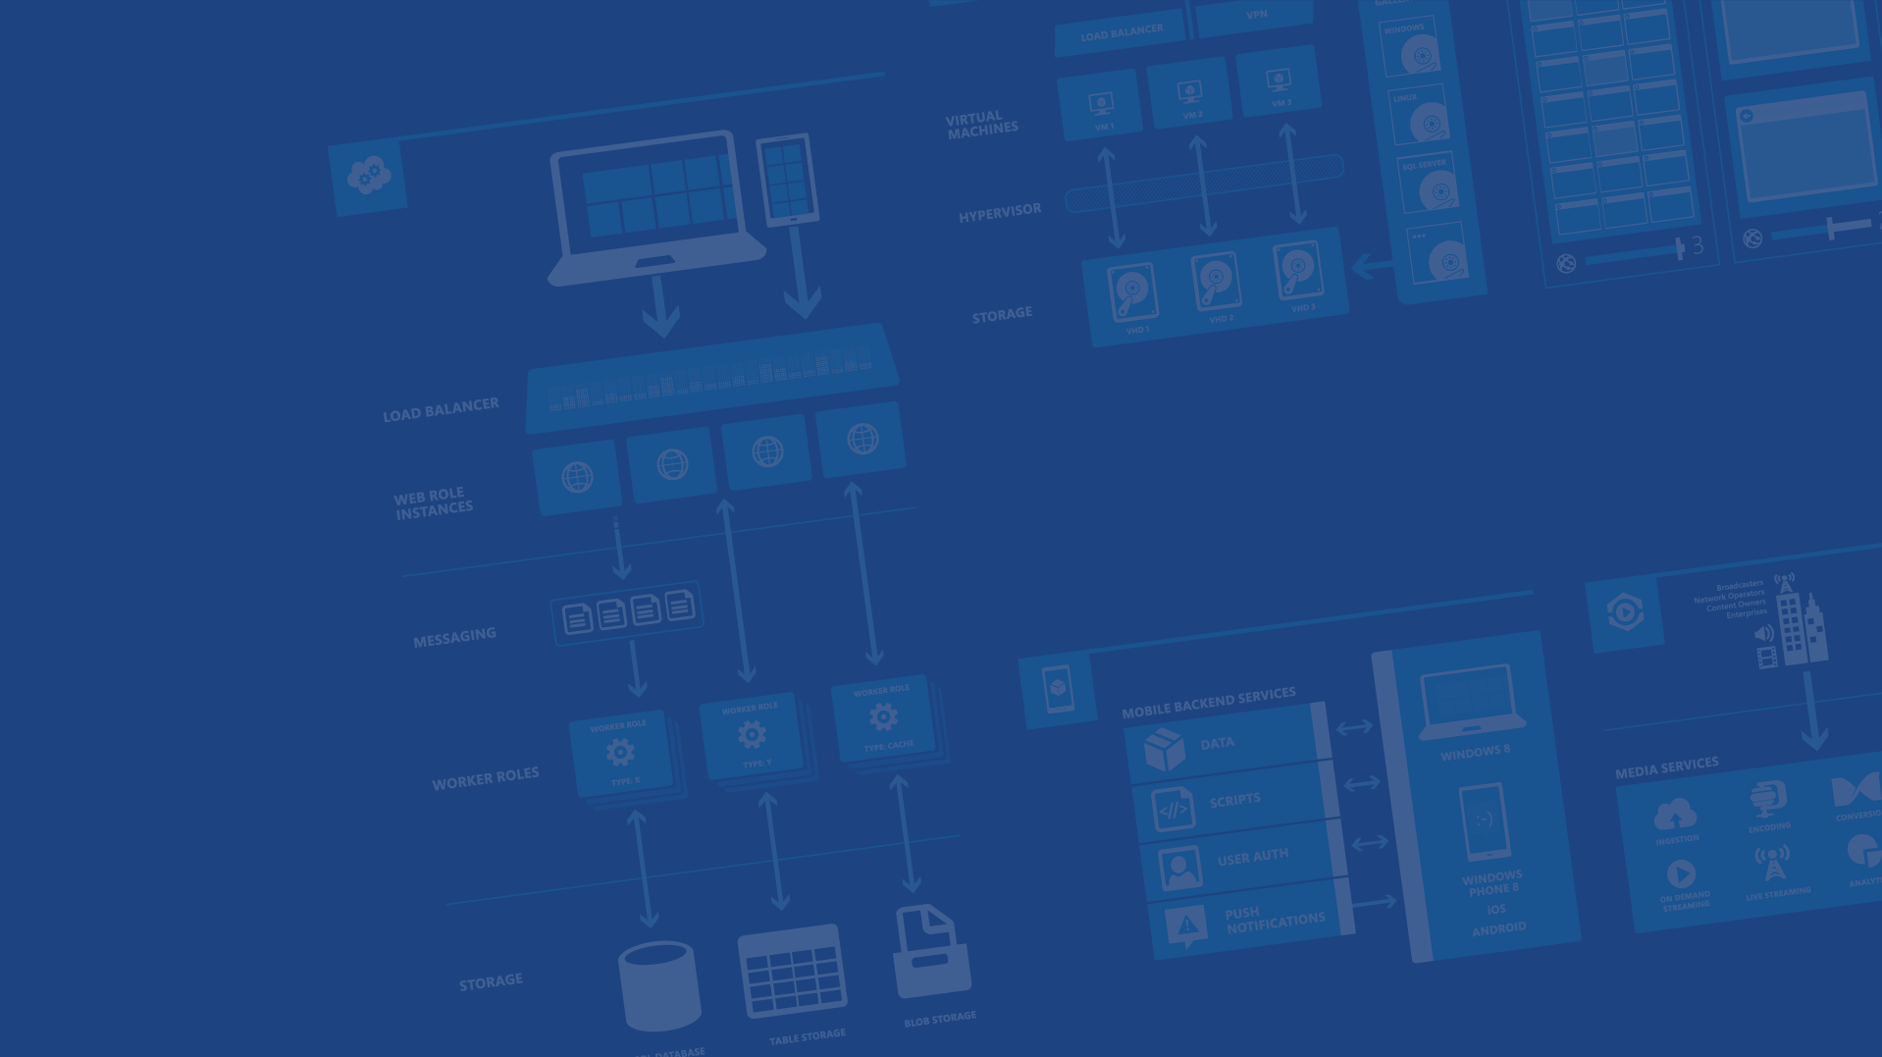
IoT Camp
Microsoft Azure
Empower your cloud IoT skills
Federico Angaramo
Microsoft Innovation Center Torino
Emanuele Quacchio
STMicroelectronics

Slide 2
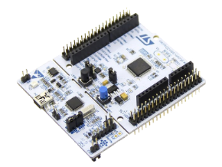


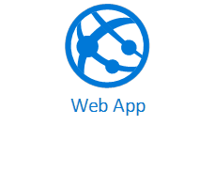

Overview
Producers
Ingestion
Transformation
(real time stream analysis)
Long term storage
Data Visualization
Azure
IoT Hub
Azure
Stream Analytics
Field
Cloud

Slide 3
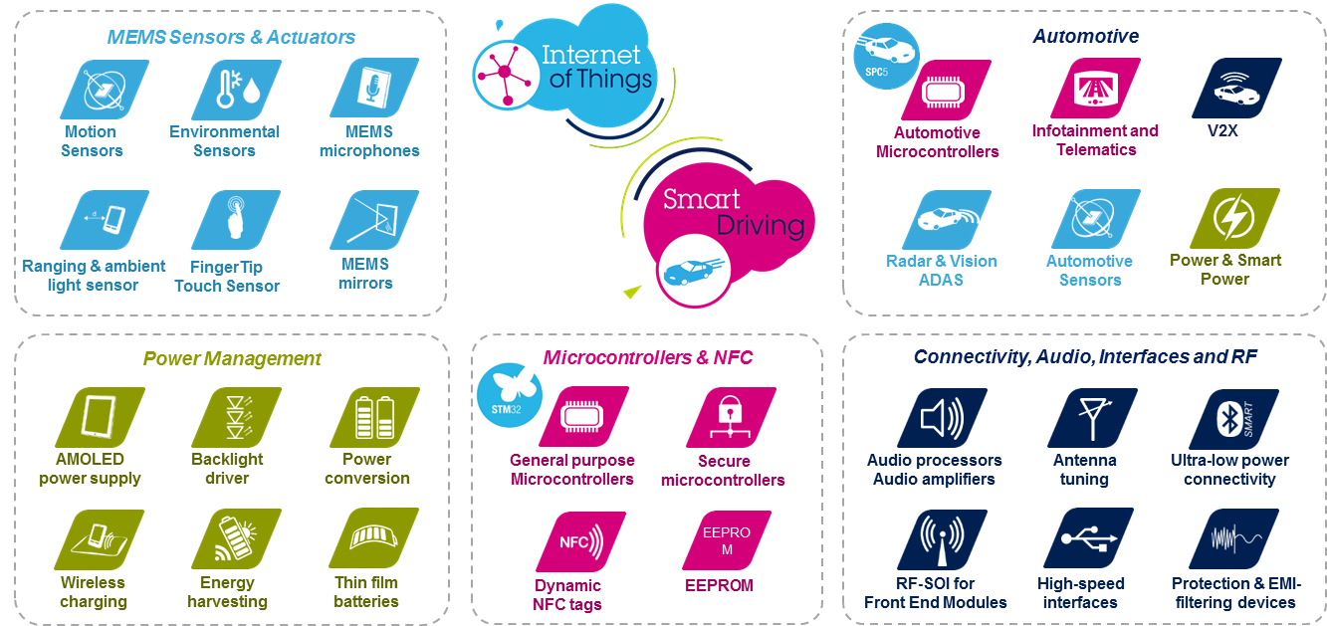
ST Product Portfolio

Slide 4

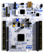
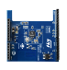

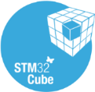
STM32ODE. Selling the ST Portfolio together
The STM32 Open Development Environment is a flexible, easy and affordable way to develop innovative applications using ST components
Over 150K boards shipped in 2015
STM32 Nucleo
development boards
STM32 Nucleo expansion boards
STM32Cube development software
STM32Cube expansion software
Function packs
SW APIs and examples enabling specific applications
Developer community and support
Compatibility with free and commercial development environments

Slide 5

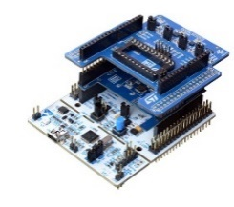
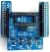
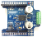
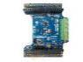

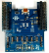
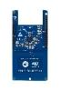
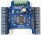
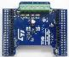

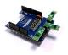
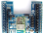
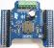
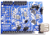
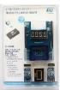
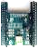

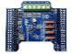
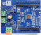
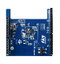
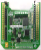
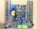

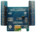
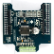
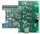
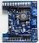

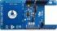
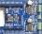
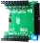
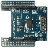
STM32 Open Development Environment
www.st.com/stm32ode
Pre-packaged offer integrating functionality from several expansion boards
28 expansion boards (and growing…) covering all the key functions
Sense
Motion MEMS & Environmental Sensors
X-NUCLEO-IKS01A1
Dynamic NFC Tag
(M24LR)
X-NUCLEO-NFC02A1
High Power Stepper Motor
(PowerStep01)
X-NUCLEO-IHM03A1
Low voltage three-phase brushless DC motor Driver (STSPIN230)
X-NUCLEO-IHM11M1
4
Connect
Digital MEMS microphones
(MP34DT01-M)
X-NUCLEO-CCA02M1
NFC card reader
X-NUCLEO-NFC03A11
Dual Brush DC Motor Driver
(L6206)
X-NUCLEO-IHM04A1
Low voltage dual brush DC motor driver
(STSPIN240)
X-NUCLEO-IHM12A1
8
FlightSense
VL6180X
X-NUCLEO-53L0A1
Wi-Fi
(SPWF01SA.11)
X-NUCLEO-IDW01M1
Bipolar Stepper Motor Driver (L6208)
X-NUCLEO-IHM05A1
Multifunctional
(Operation Amplifier)
X-NUCLEO-IKA01A1
Power
Drive
FlightSense
VL53L0X
X-NUCLEO-6180XA1
Sub-1 GHz RF
(SPSGRF-868,)
X-NUCLEO-IDS01A4
Battery operated stepper motor driver (STSPIN220)
X-NUCLEO-IHM06A1
Sound Terminal
(STA350BW )
X-NUCLEO-CCA01M1
2
Move Actuate
Bluetooth Low
Energy (BlueNRG)
X-NUCLEO-IDB04A1
Sub-1 GHz RF
(SPSGRF-915)
X-NUCLEO-IDS01A5
3-phase Brushless DC Motor Drivers
(L6230)
X-NUCLEO-IHM07M1
Industrial Input/Output
(CLT01-38SQ7, VNI8200XP)
X-NUCLEO-PLC01A1
11
Bluetooth Low Energy (SPBTLE-RF)
X-NUCLEO-IDB05A1
Stepper Motor Driver
(L6474)
X-NUCLEO-IHM01A1
Low-Voltage BLDC Mot. Drv
(F7 MOSFET)
X-NUCLEO-IHM08M1
LED lighting
(LED6001)
X-NUCLEO-LED61A1
Translate
Dynamic NFC Tag
(M24SR)
X-NUCLEO-NFC01A1
Two Axes Motor Driver (L6470)
X-NUCLEO-IHM02A1
Motor CTRL Connector
X-NUCLEO-IHM09A1
24V Intelligent Power Switch
(VPS2535H)
X-NUCLEO-IPS02A1
3

Slide 6


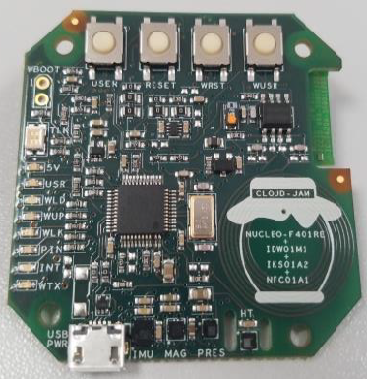
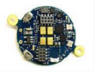

From Prototype to Form Factor
Third Parties
Third Parties
Final Device
Modular Blocks Prototyping
Form Factor Field testing
Optimized Design
Volume Production
100% Software Compatibility

Slide 7


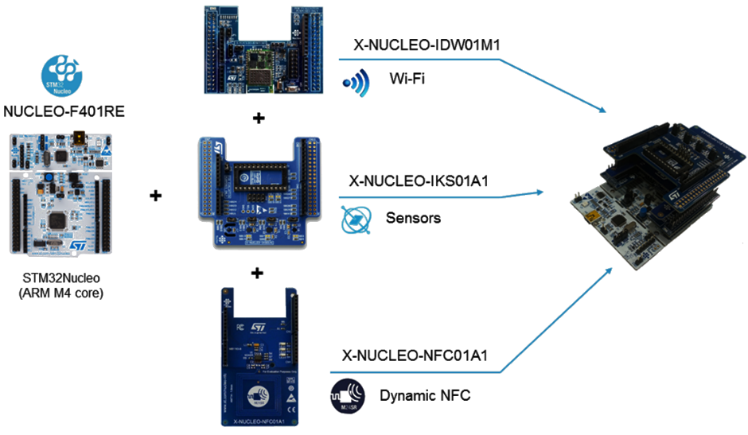


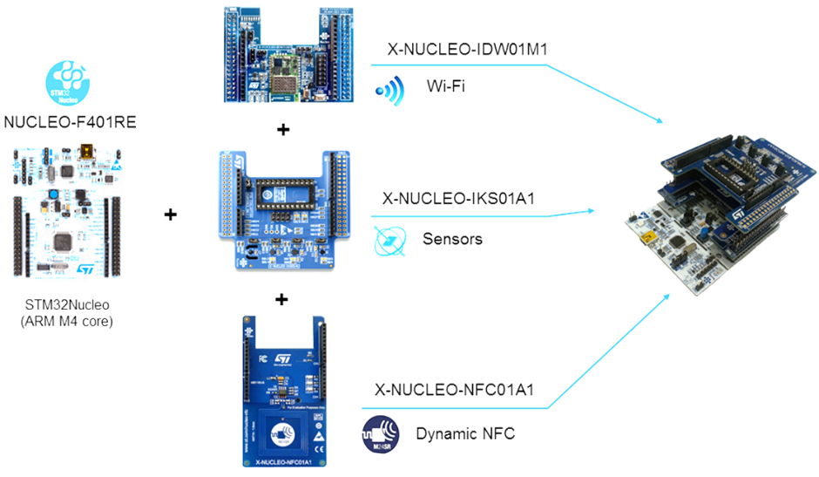
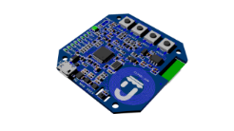
Example: Cloud Jam
www.rushup.tech
First example of integrated trial & production board for the cloud function packs (more info: http://www.rushup.tech/jam/)
X-NUCLEO-IDW01M1
X-NUCLEO-IKS01A2
X-NUCLEO-NFC01A1
100% HW and SW compatible with
FP-CLD-AZURE1
in production form factor

Slide 8
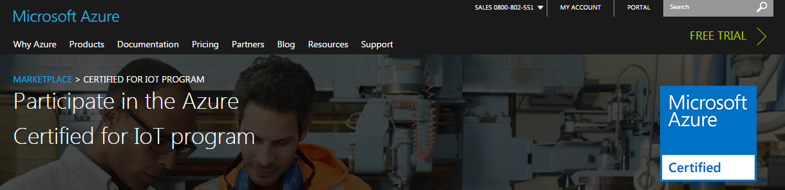
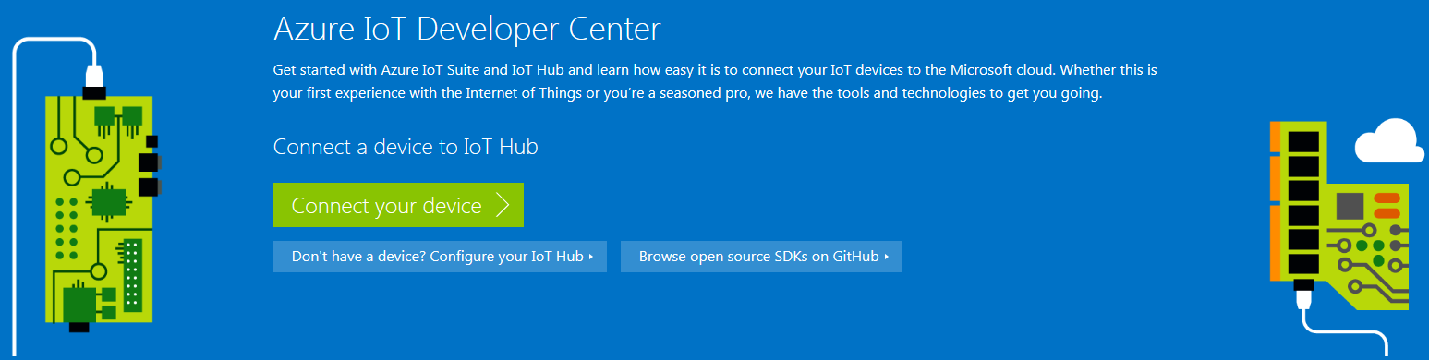
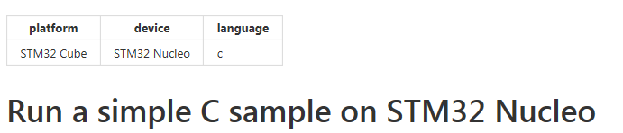
Microsoft Azure Certification

Slide 9
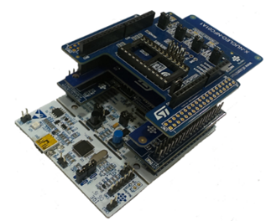
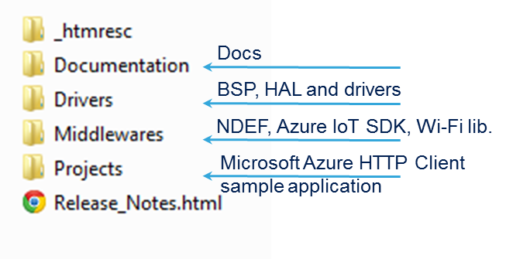


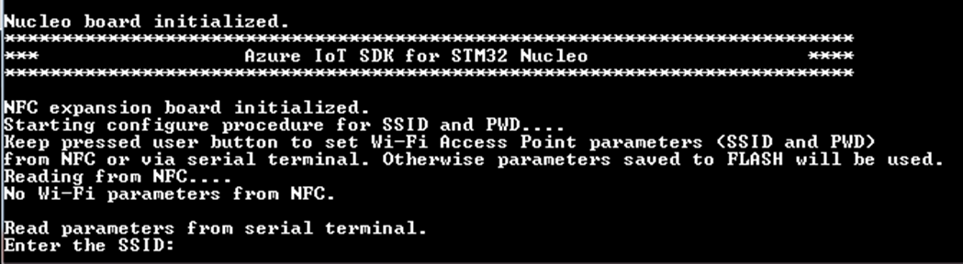

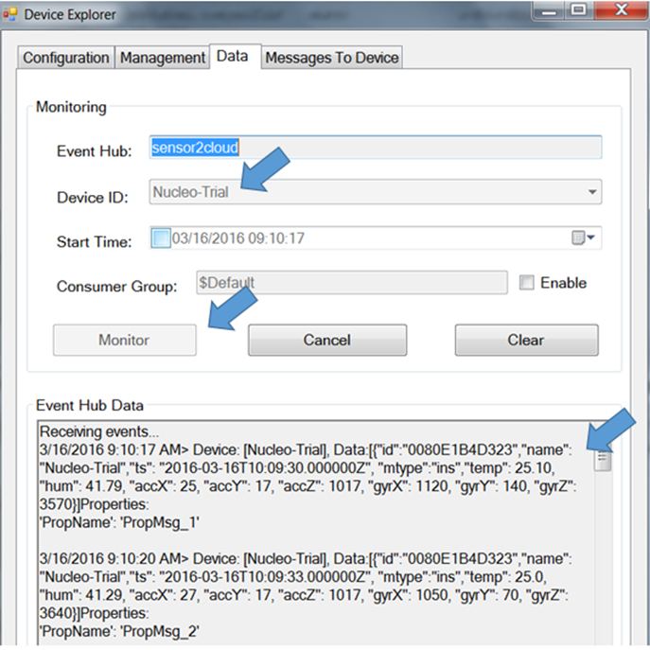
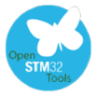
FP-CLD-AZURE1
www.st.com/stm32ode-fp
Update code with Connection String
Visualize data log
IoT Hub Registration

Slide 10
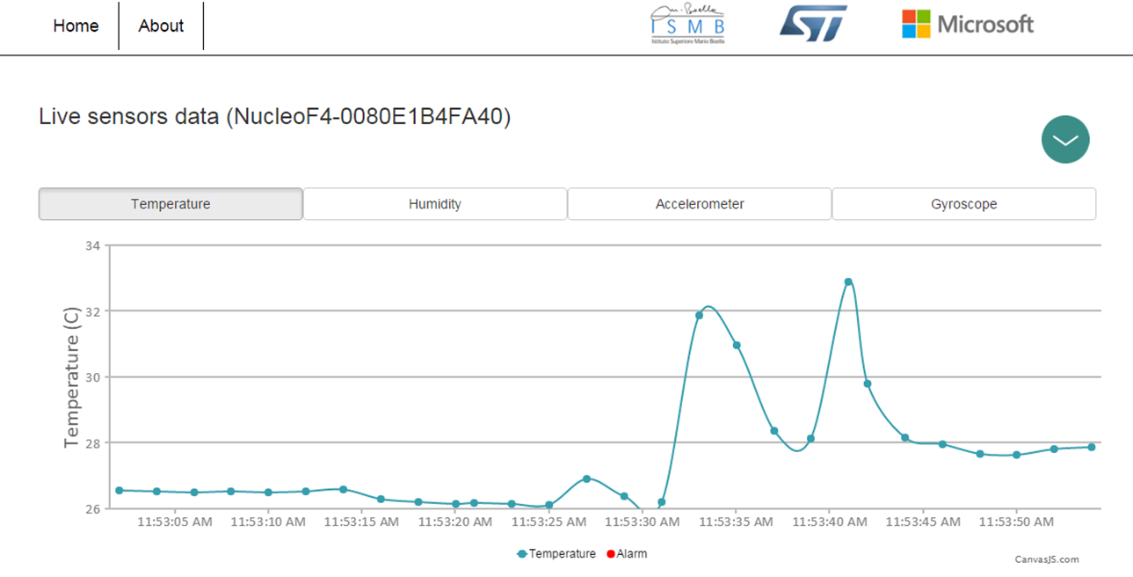
FP-CLD-AZURE1 - Sensor to Cloud
Web Dashboard
Temp., Hum., Press.
Inertial
Alerts
Commands:
LED on/off
Samples freq.
Quit

Slide 11
Overview
Producers
Ingestion
Transformation
(real time stream analysis)
Long term storage
Data Visualization
Azure
IoT Hub
Azure
Stream Analytics
Field
Cloud

Slide 12

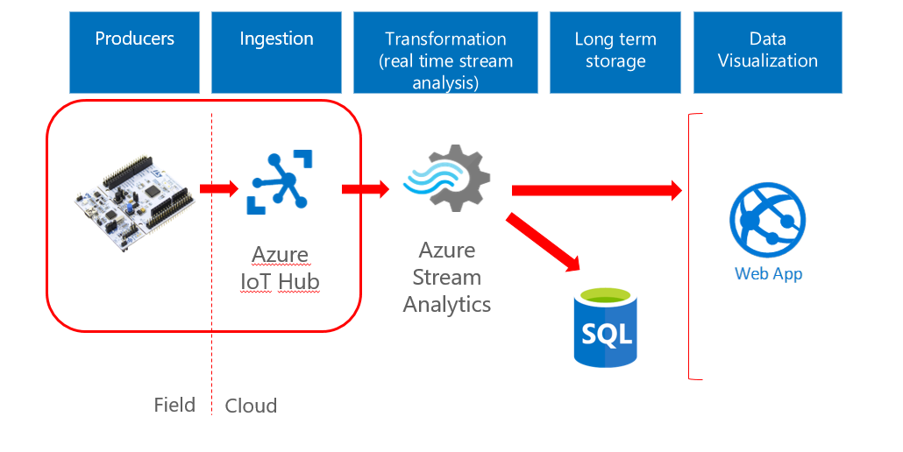
Device registration
1
2
3
Api Apps
4
Azure
IoT Hub
Field
Cloud

Slide 13
Overview
Producers
Ingestion
Transformation
(real time stream analysis)
Long term storage
Data Visualization
Azure
IoT Hub
Azure
Stream Analytics
Field
Cloud

Slide 14
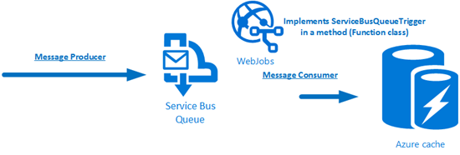



Communication flow
Warning/Disable device
Restriction
Telemetry
EventHub
Azure
IoT Hub
Azure
Stream Analytics
Log
Field
Cloud
Alert / Message back

Slide 15


Stream analytics I/O

Slide 16

Stream analytics query
Telemetry
Log
Restriction

Slide 17
DEMO

Slide 18


One integrated offering
Web Apps
Mobile Apps
Web apps that scale with your business
Build Mobile apps for any device
LOGIC Apps
Api Apps
Automate business process across SaaS and on-premises
Easily build and consume APIs in the cloud

Slide 19


EventHub Partitioning

Slide 20


EventHub Consumers

Slide 21



IotHub – Device Twin
Only MQTT

